Slide 1
CO2301 - Games Development 1
Week 6
Introduction To Pathfinding + Crash and Turn + Breadth-first Search
Gareth Bellaby

Slide 2
Topics
Introduction to Pathfinding
Crash and turn
Grids
Breadth-first search

Slide 3
Topic 1
Introduction to Pathfinding

Slide 4
Approach
Physical. Pathfinding involves a physical search. Later look at using search techniques for decision making. The same technique of using a search tree is used for both pathfinding and decision making.
Definition: "Finding a route between two points".

Slide 5
Article
You must read the following article:
"Smart Moves: Intelligent Pathfinding" by Bryan Stout:
http://www.gamasutra.com/features/19990212/sm_01.htm

Slide 6
Pathfinding
Why do pathfinding?
Gameplay.
Realism.
Movement without having to consider collision detection, etc.
Reduces real-time calculations.

Slide 7
Why bother?
Might find that moving towards the goal is straightforward.
  ...But what about obstacles
Could try a steering approach.
  e.g. just deal with obstacles as you come across them.
  very inefficient
  Possible to get stuck
Planning turns out to be a far better approach. Map out the world and then plan a route through it.

Slide 8
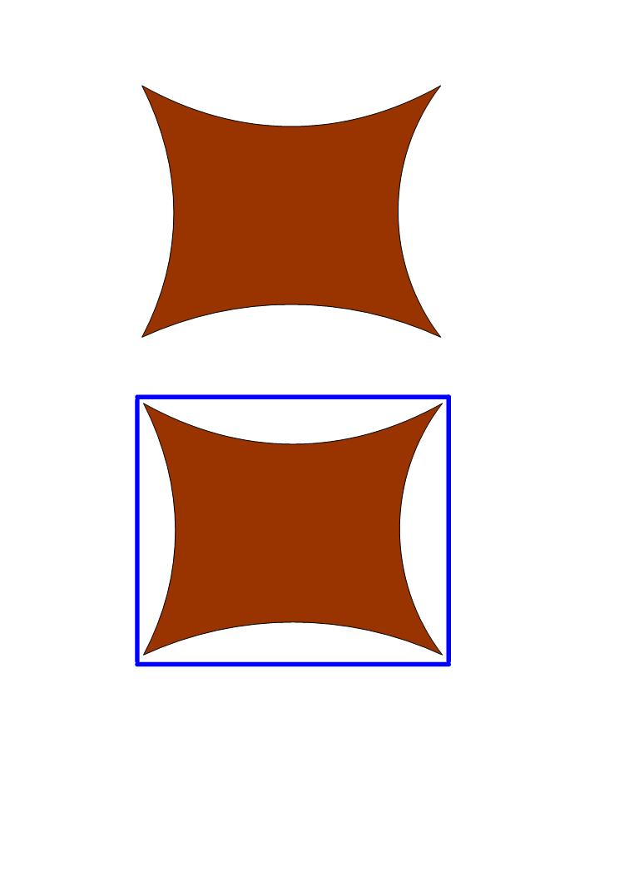
Concave Objects
As a general rule pathfinding techniques work better with convex objects.
Treat concave objects as convex.
Movement which describes a convex shape even looks more natural.
Don't have to be exact. Easier and more natural to stand proud of the points.
Work with the level designer.

Slide 9
Topic 2
Crash and turn

Slide 10
Crash and Turn
The simplest form of pathfinding.
  Simply trace a direct line between your current position and your goal.
  Follow this line.
  If you crash into an obstacle then move left or right. Follow the edge of the obstacle until you pick up a direct line again.
  Follow the line once again.

Slide 11
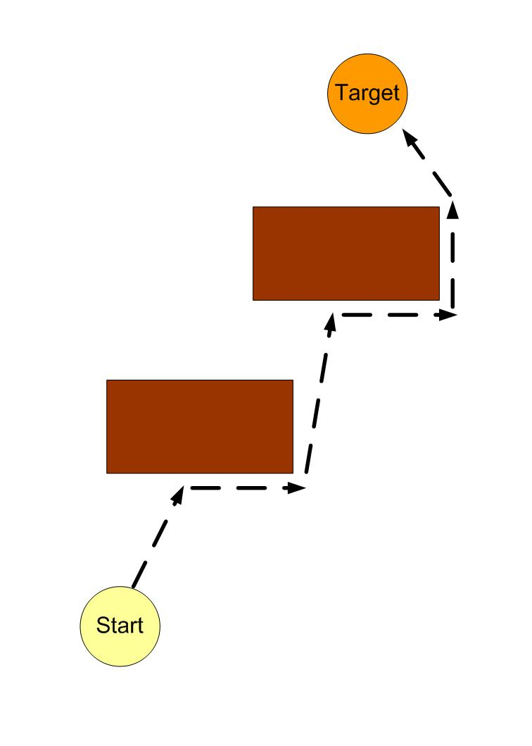
Crash and Turn
b

Slide 12
Crash and Turn
Guaranteed to work so long as all objects are convex.
Use a convex hull. You have employed convex hulls in Collision Detection. Note that an object is a set of points. You know how calculate the bounding box.

Slide 13
Topic 3
Grids

Slide 14
Representation & Reasoning
Most AI is based on symbol manipulation, i.e. a set of symbols with a set of procedures for operating on them.
Knowledge is representation and the methods for manipulating it.
Representation is a necessity for pathfinding. The real world is too difficult to reason with. A good representation can make reasoning much easier.
(As it turns out, pathfinding in a dynamic environment with multiple agents is extremely difficult even using a simplified representation of the world.)

Slide 15
Pathfinding
Use a square grid.
For our purposes only vertical or horizontal movement will be allowed.
Derive the best past from start to goal.
Apply some sort of smoothing algorithm to smooth the abrupt turns and so produce more natural looking movement.
For our purposes, the horizontal movement will be referred to as movement North, East, South and West.

Slide 16
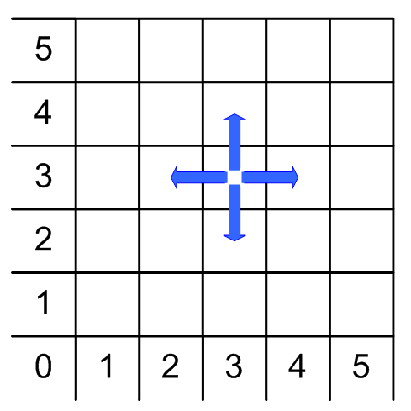
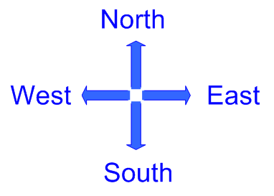
Grid
Diagram of grid

Slide 17
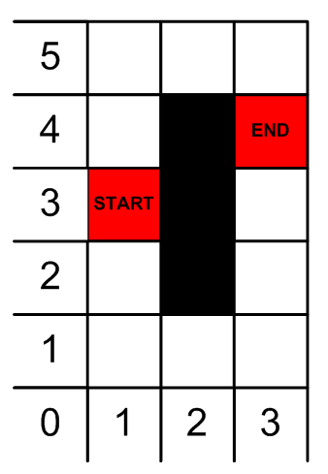
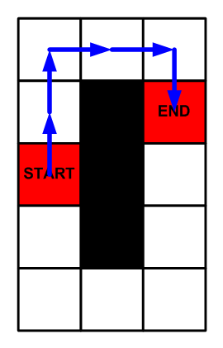
Pathfinding
Pathfind using grid
Horizontal and vertical only
Impose a grid.

Slide 18
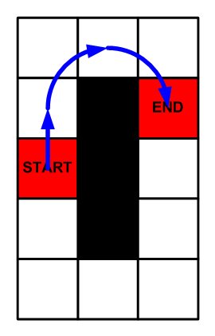
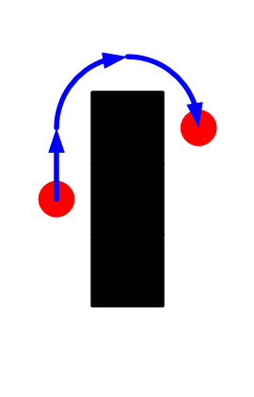
Pathfinding
Use path smoothing
User view

Slide 19
Pathfinding and Reasoning
Always:
  Representation
  Reasoning (using this representation)
  Apply to the world.
Algorithms must be followed. If precisely implemented then they will work.

Slide 20
Efficiency - AI Budget
Efficiency is important for games.
The budget is the amount of CPU time allocated to AI. The AI budget is around 10%-20% of the CPU load.
If a game runs at 60fps this means that all the calculations must be done in 1/60th second. Given 10%-20% of CPU load this means 0.00167 -0.00333 seconds, or an average of around 2 milli-seconds.
At game running at 30 fps will probably allow you about 7 milliseconds for you AI in a single run through of the game loop. This is generous.
Pathfinding algorithm and implementation must be fast.

Slide 21
Topic 4
Breadth-first search

Slide 22
Breadth-first
The breadth-first algorithm always expands those nodes that are closest to the start node.
On the grid we examine:
  the starting location,
  followed by locations 1 square away
  followed by locations 2 squares away
  and so on...

Slide 23
Implementing searches
All the search algorithms use lists.
The list is a list of coordinates. Each coordinate represents one location on the grid.
The algorithms use an Open List and a Closed List.
A coordinate is pushed onto a list or popped from a list.
The Open List is a First In, First Out list for the breadth-first search (FIFO).
A "rule" is the generation of a new coordinate from an existing coordinate. There are four rules: north, east, south and west.

Slide 24
Implementing searches
The x axis is horizontal. Movement right is positive x. The y axis is vertical.
North will is upwards.
North increments y by 1.
East increments x by 1.
South decrements y by 1.
West decrements x by 1.
For example, given (5, 5) four successor locations would be generated:
N (5, 6) E (6, 5) S (5, 4) W (4, 6)

Slide 25
The Breadth-first Algorithm
1) Create OpenList and ClosedList
2) Push the initial state (start) on to OpenList
3) Until a goal state is found or OpenList is empty do:
  (a) Remove (pop) the first element from OpenList and call it current.
  (b) If OpenList was empty, return failure and quit.
  (c) If current is the goal state, return success and quit
  (d) For each rule that can match current do:
    i) Apply the rule to generate a new state
    ii) If the new state has not already been visited, push the new state to end of OpenList.
  (d) Add current to ClosedList

Slide 26
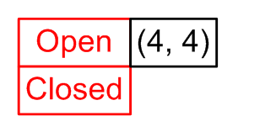
Worked example
Step 1. create Open and Closed.
Step 2. Start is (4, 4), push onto Open .
The "not visited" test will be implemented by comparing the coordinates to all of the coordinates currently on the Open list and the Closed List.

Slide 27
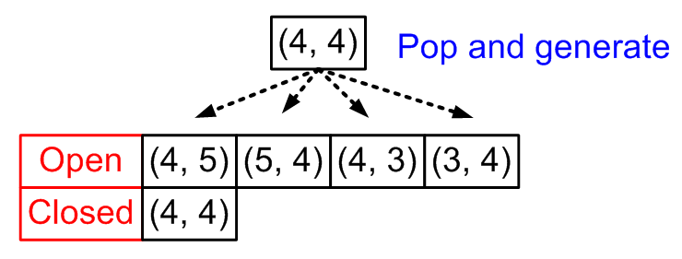
Worked example
Step 3.
Pop first element and call it current. Current is
(4, 4)
Apply the four rules.
  N generates (4, 5). Not visited so push (4, 5) onto Open.
  E generates (5, 4). Not visited so push (5, 4) onto Open.
  S generates (4, 3). Not visited so push (4, 3) onto Open.
  W generates (3, 4). Not visited so push (3, 4) onto Open.
Push current onto Closed.

Slide 28
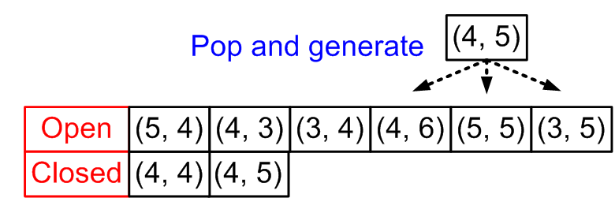
Worked example
Step 3 again.
Pop first - current is
(4, 5)
Apply the four rules.
  N generates (4, 6). Push (4, 6) onto Open.
  E generates (5, 5). Push (5, 5) onto Open.
  S generates (4, 4). Already visited so ignore.
  W generates (3, 5). Push (3, 5) onto Open.
Push current onto Closed.

Slide 29
Search Tree (Graph)
Trees are a basic structure within AI.
The nodes, linked together, form a tree-like structure.
The whole tree is described as the search state (or problem state)
A breadth-first search grows the bottom edge of the search tree.

Slide 30
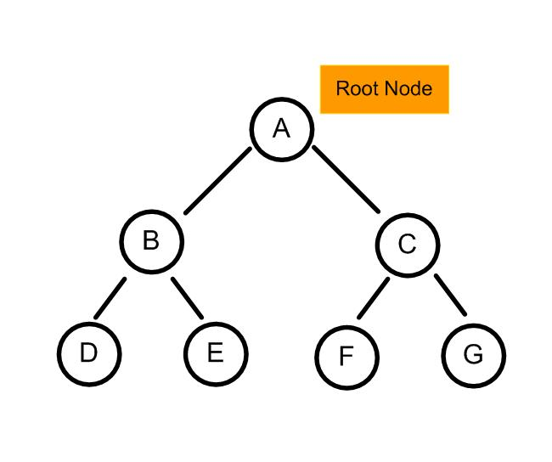
Search Tree (Graph)
b

Slide 31
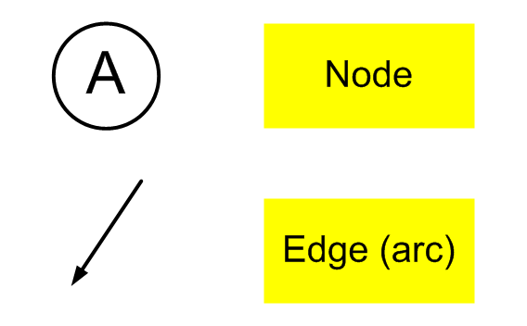
Trees
b

Slide 32
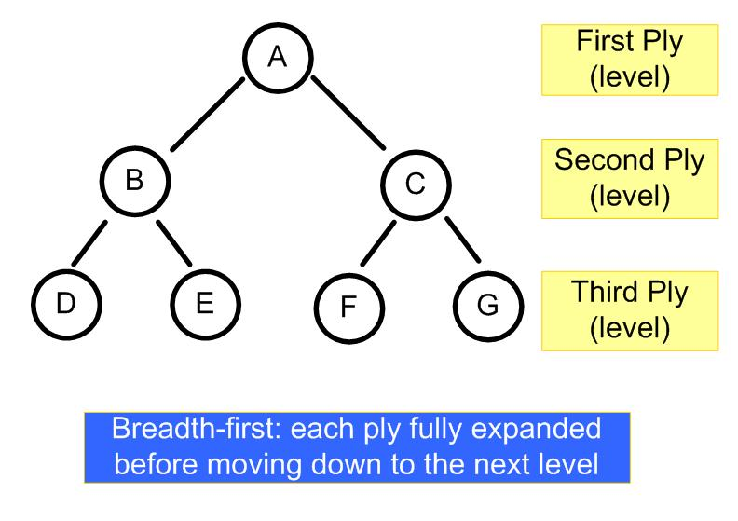
Breadth-first
b

Slide 33
Advantages & Disadvantages
Is the search guaranteed to find a solution?
  Yes
Is the search guaranteed to find an optimal solution?
  Yes
Is it efficient?
  No, because the whole of the problem space is searched. Breadth-first is an example of an exhaustive search.

Slide 34
Exercise
Apply the breadth-first algorithm to map A. Employ the algorithm step-by-step. Show exactly how the nodes are:
  generated,
  pushed onto the OpenList,
  popped from the OpenList
  pushed onto the ClosedList.
OpenList is a FIFO list.
ClosedList is an unordered list/
Use letters to designate the grid locations being searched. The starting grid is 'A'. The subsequent grid locations follow on directly: B, C, D. etc.

